Slide 1

Utah Poison Control Center
Keeping Families Safe

Slide 2

MISSION STATEMENT
To prevent and minimize adverse effects from a poison exposure through education, service, and research

Slide 3

Utah Poison Control Center (UPCC) Staff
Registered nurses
Registered pharmacists
Medical doctors
Health educators

Slide 4
UPCC History
The UPCC was established in 1954
It is located within the University of Utah, College of Pharmacy
It serves all of Utah

Slide 5
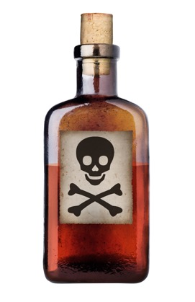

What Is A Poison?
A poison is anything someone eats, breathes, gets in the eyes or on the skin, that can cause sickness or death if it gets into or on the body.
Poisons come in different forms
  Solid
  Liquid
  Gas or spray

Slide 6
Utah’s Poison Problem
40,000 calls on average each year
90% occurred in the home
80% were managed on-site with telephone follow-up
Source: Utah Poison Control Center

Slide 7
Age Distribution of Poison Exposures
Source: Utah Poison Control Center
Notes:
20-59 many due to unintentional overdose

Slide 8
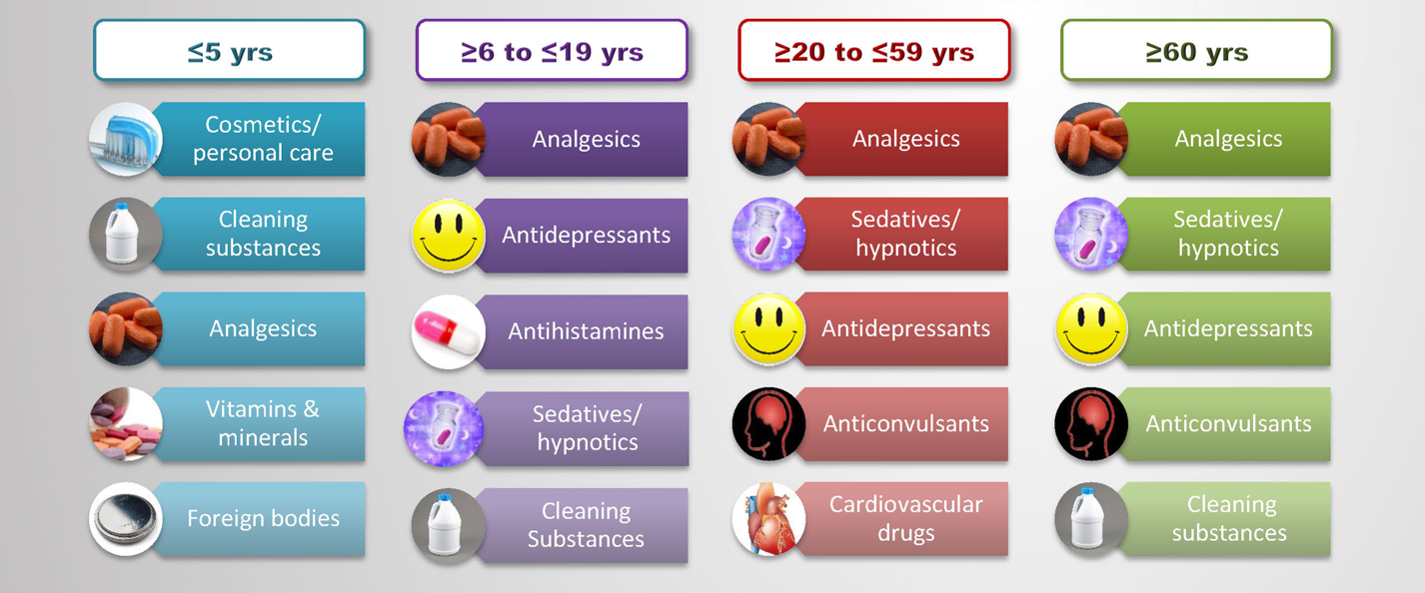
Most Common Poison exposures by age group
Source: Utah Poison Control Center
Notes:
Analgesics: Pain medicine (anti-inflammatories like acetaminophen and ibuprofen, as well as prescription pain medicine)
Sedatives: Valium, sleep medications, anxiety
Antipsychotics: mentally ill, Zyprexa, Seroquel, schizophrenia
Homeopathic: Highlands Teething Tablets

Slide 9
When Do Poisonings Occur?
When the product is in use
  Adult distraction
Peak age
  18 months old
Source: Utah Poison Control Center

Slide 10

Why Are Children More Likely to be Poisoned and What Factors Place Them At Risk?

Slide 11

Stages of Development
Infants (0 – 6 months)
  Most infant poisonings are result of
  adult error; wrong dose, wrong medicine
Crawlers (6 months – 1½ yrs.)
  Explore everything within reach and put
  things in their mouth
Toddlers and pre-schoolers (1½ yrs. – 3 yrs.)
  Reach higher, nothing is child-proof, look-alikes are deceiving

Slide 12

Factors That Increase Risk
Child’s curious nature
  Explore, taste, and touch
  to learn
Improper storage
  Lock it up; keep out of reach
Adult distractions
  Telephones, doorbells, meal preparation, etc.
  Most poisonings occur when the product is in use

Slide 13

What Are These Poisons and What Should We Do About Them?

Slide 14
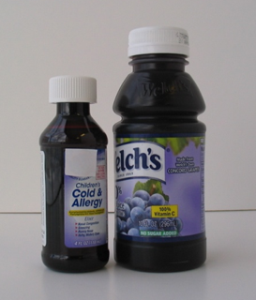
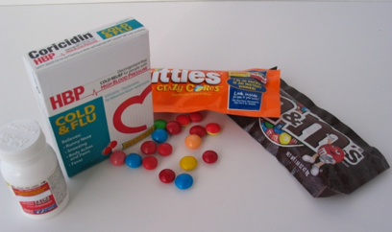
Medicines and Vitamins
Pain relievers
Cough and cold medicines
Heart, blood pressure drugs
Antidepressant medications
Vitamins – especially iron, and herbal supplements
Notes:
Pain relievers (ibuprofen, acetaminophen, aspirin)
Cough and cold medicines (decongestants, antihistamines, cough suppressants)
Antidepressant medications (Prozac™, Wellbutrin™, Zoloft™, etc)

Slide 15
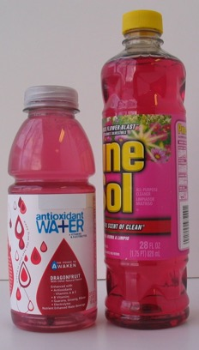
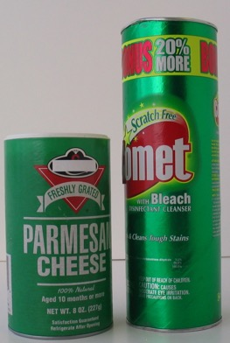
Household Products
Bleach
Drain and toilet bowl cleaners
Laundry products
Ammonia cleaners
Dish detergent
Oven cleaners
Notes:
Laundry products (laundry packets, detergent, fabric softener, starch)
Ammonia cleaners (glass ckeaners)

Slide 16
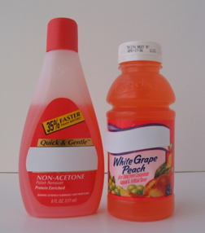
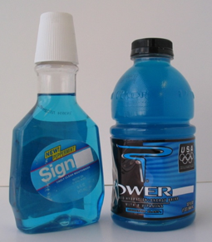
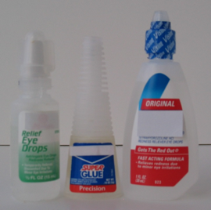
Cosmetic and Personal Care Products
Mouthwash, toothpaste
Nail products
(particularly polish remover)
Shampoo
Perfume
Talcum
Lotion
Make-up
Notes:
Even one swallow of mouthwash can be deadly to small toddler

Slide 17
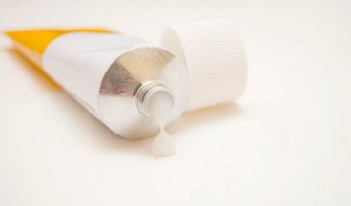
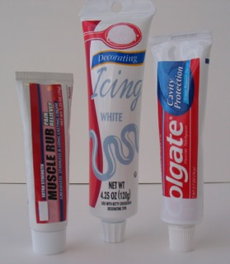
Topicals
Acne preparations
Diaper products
Topical steroids (cortisone cream)
Athletic rubs

Slide 18
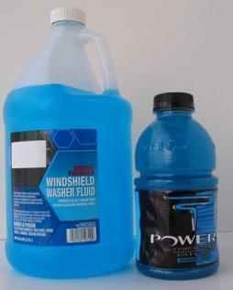

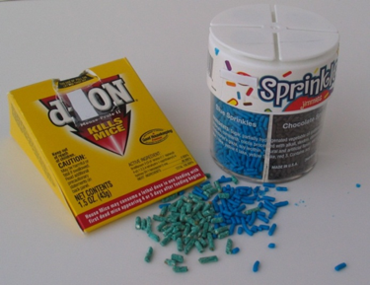
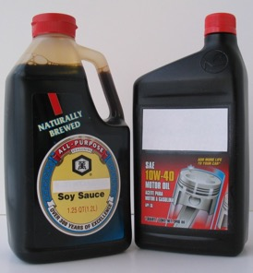
What’s in the Garage?
Gasoline
Motor oil
Windshield washer fluid
Pesticides
Anti-freeze

Slide 19
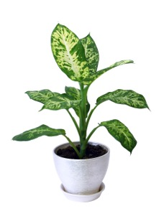
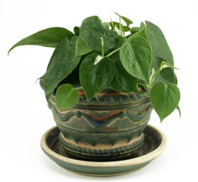
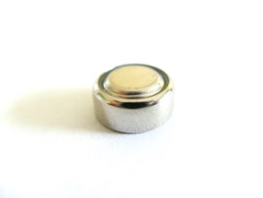

Miscellaneous Poisons
Plants
  Philodendron, Virginia creeper,
  dieffenbachia, iris, nightshade
Foreign bodies
  Coins, button batteries, hearing aids
Food Products
  Cook at correct temperatures, store and thaw correctly, don’t cross contaminate, when in doubt…throw it out.

Slide 20
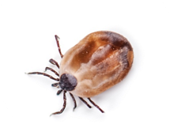
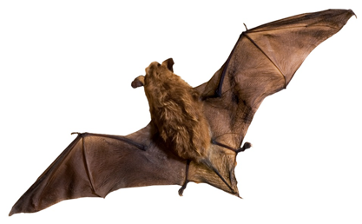
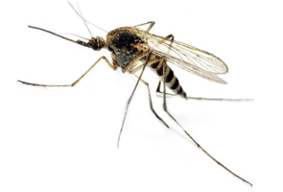
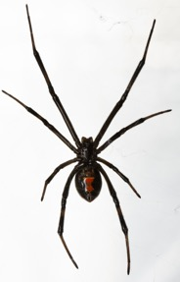
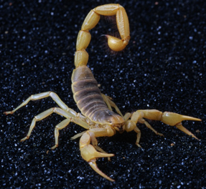
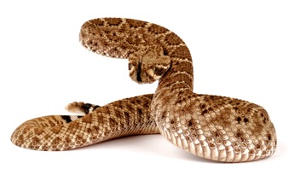
Miscellaneous Poisons
Bites and Stings
  Rattlesnakes
  Bees and Wasps
  Spiders
  Ticks
  Bats
  Scorpions
Hogle Zoo

Slide 21

Prevention- Takeaways
Keep out of reach of children
  Out of sight and out of reach
Keep in original containers
Use child-resistant cap
Be aware of multiple ingredients
Never call medicine “candy”
Use according to instructions
Attend to open product

Slide 22
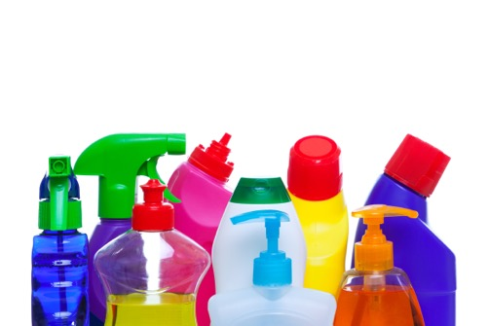
Prevention
Protect skin and eyes from contact
Only purchase amount you will use
Properly dispose of leftover
and old chemicals
Do NOT follow first-aid
instructions on package,
call poison control
Do not mix products

Slide 23

Carbon Monoxide (CO)
A colorless, odorless, tasteless gas
Signs of CO poisoning:
  - Headache
  - Fatigue
  - Nausea
  - Dizziness
  - Irregular breathing
  - Mental confusion
  - Unconsciousness
  - Ultimately death

Slide 24

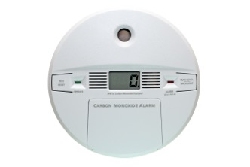
Prevention
Install a CO detector near sleeping areas
Never operate gas burning appliances, machines or equipment in an enclosed space (garage, tent, indoor spaces)
Have chimney and flue cleaned professionally
Have furnace inspected annually

Slide 25

Adult Poisonings
Poison is not just a problem for children
25% of calls to the UPCC each year are for adults over age 19
That equates to about 10,000 calls

Slide 26
First aid tips
Swallowed poison
  do not give anything, call the poison control center
Inhaled poison
  get victim to fresh air, call poison control center
Poison on skin
  remove contaminated clothing and rinse skin with water for 10 minutes, call the poison control center
Poison in eye
  flush eye for 15 minutes using a large cup filled with lukewarm water held 2-4 inches from eye, call the poison control center

Slide 27

Emergency Action For Poisoning
Remain calm, but don’t wait for the person to look or feel sick; some exposures can have a delayed effect
If the person is unconscious, having convulsions, or difficulty breathing;
call 911
Otherwise call the UPCC at:
1-800-222-1222

Slide 28

Calling Poison Control
Questions the UPCC specialist may ask:
  How the person is feeling or acting right now
  Age and weight of person
  Name/description of
  medicine, product or plant
  (have container with you)
  Amount taken
  When it happened
  Name and phone number

Slide 29

Conclusion
We come in contact with many poisons every day
Awareness and simple safety precautions can help keep us, and our children safe and well
Implement prevention strategies in your surroundings to stop poisonings
Don’t hesitate to call poison control

Slide 30
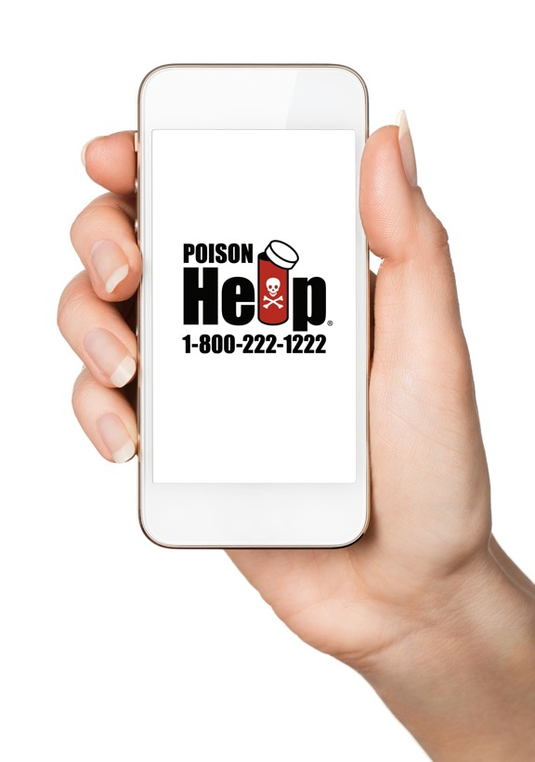
Save the Poison Control number in your phone… Someday it may save you back!

